Slide 1
FULLSTACK
Backend Programming

Slide 2
Interface

Slide 3
Interface
The interface is a collection of method definitions that have no contents (only definitions), and are wrapped in a specific name.
It’s data type
Can be used if there is a value
The value of interface is concrete objects that have a method definition are at least the same as those in the interface

Slide 4
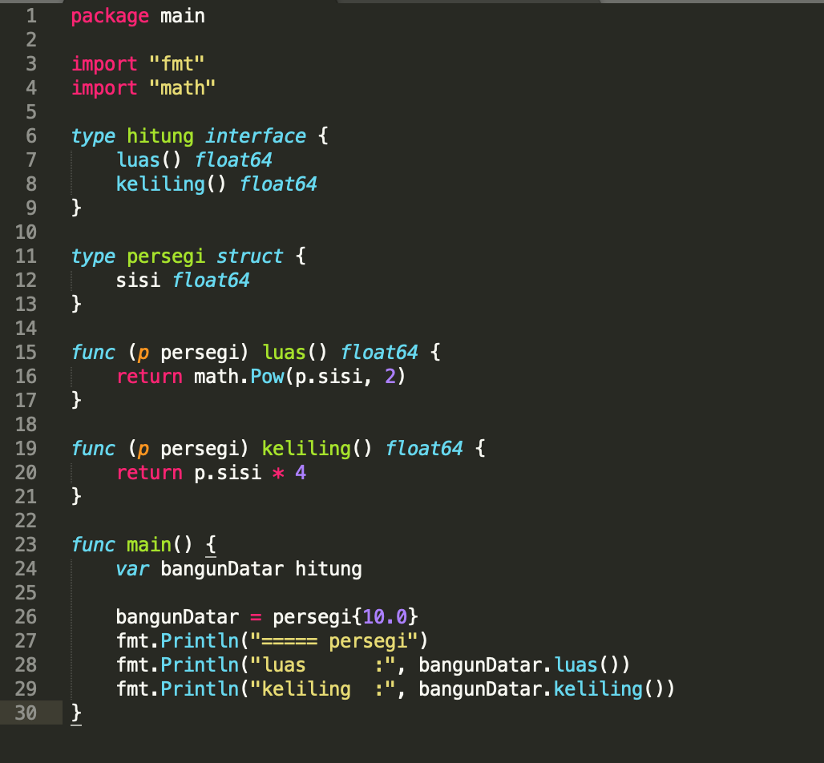
Interface

Slide 5
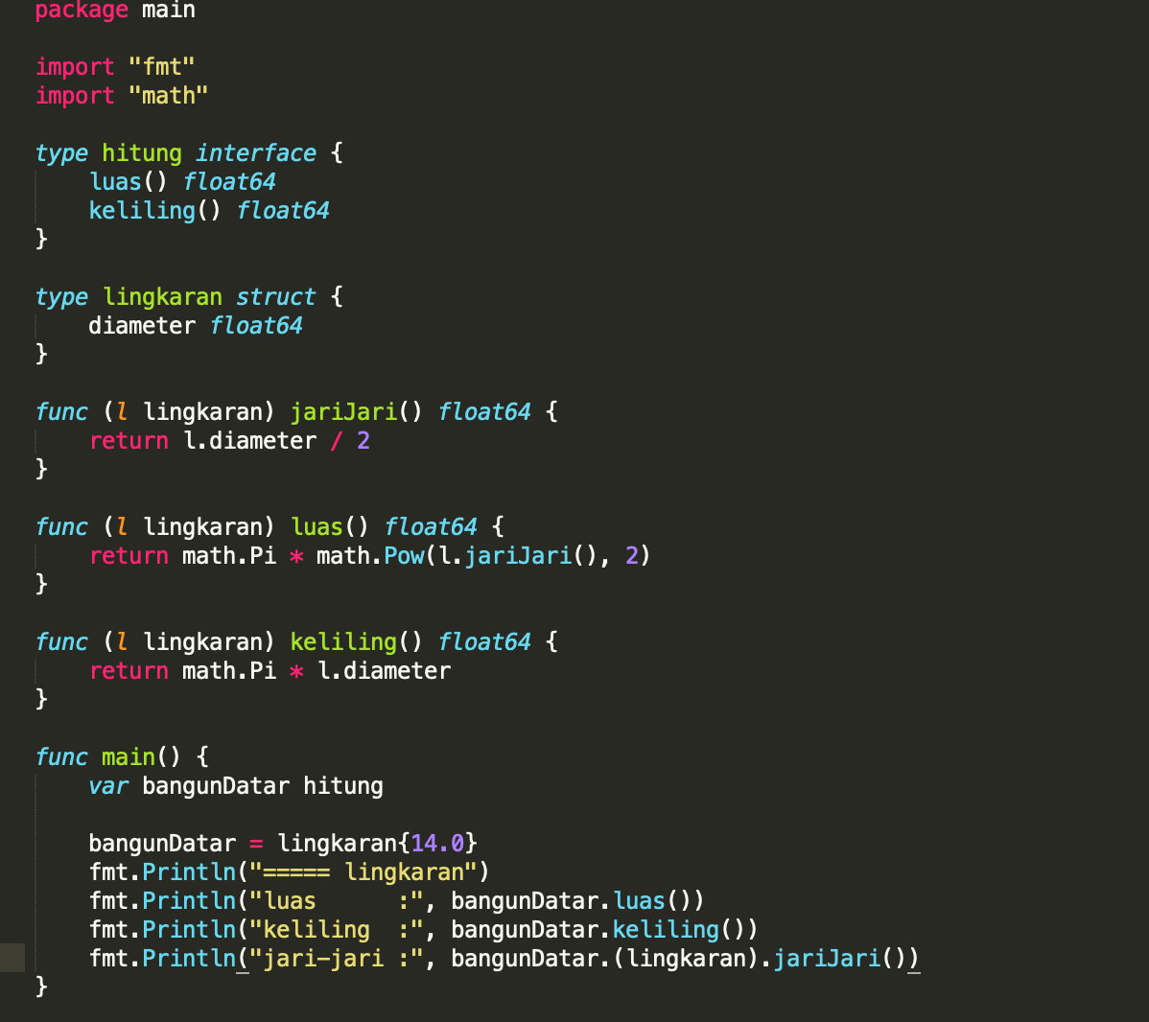
Let’s try !

Slide 6
Package

Slide 7
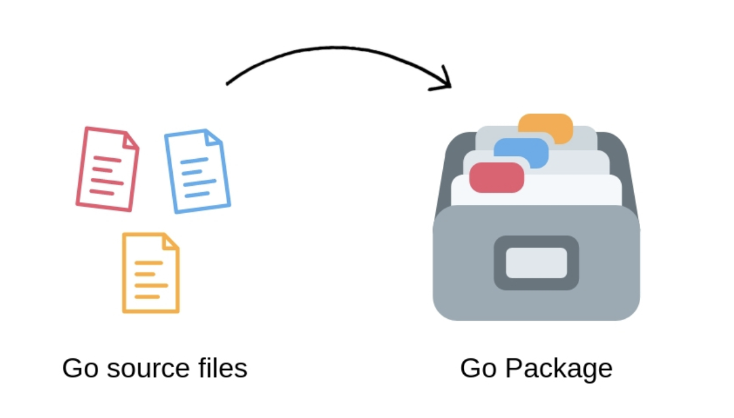
Package

Slide 8

Package
The package declaration must be the first line of code in your Go source file.

Slide 9
Package - Benefit
It reduces naming conflicts
It organizes related code together so that it is easier to find the code you want to reuse
It speeds up the compilation process by only requiring recompilation of smaller parts of the program that has actually changed

Slide 10
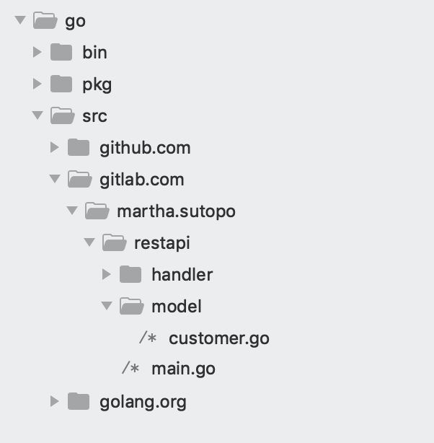
Package
The bin and pkg folders contain the binary executable and the package archives respectively

Slide 11
Import

Slide 12
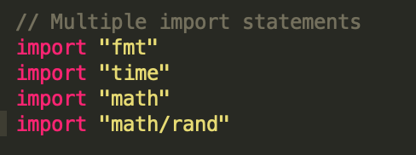
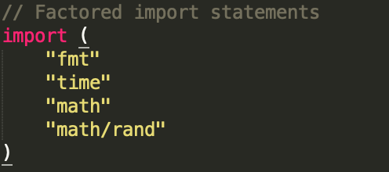
Import
Multiple Import
Factored Import

Slide 13
Summary
Interface
Package
Import

Slide 14


